Slide 1


A first collective validation of global
fluvial flood models for major floods
in Nigeria and Mozambique
Mark Bernhofen PhD Student - University of Leeds cn13mvb@leeds.ac.uk
Whyman, C., Trigg, M., Sleigh, A., Smith, A., Sampson, C., Yamazaki, D., Ward, P.,
Rudari, R., Pappenberger, F., Dottori, F., Salamon, P., Winsemius, H.
GFP Conference, Delft. Session 1 – 25 June, 2018

Slide 2
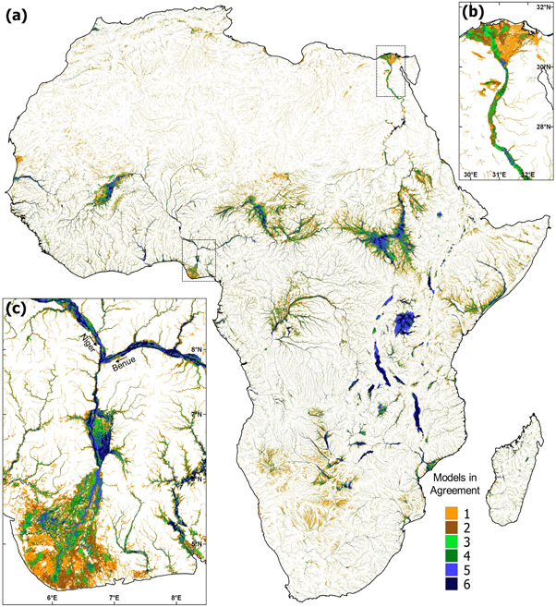
Background
Global flood model intercomparison study by Trigg et al¹ compared the flood hazard output of 6 global flood models in the continent of Africa.
6 models compared in the study were: CaMa-Flood, CIMA-UNEP, ECMWF, GLOFRIS, JRC, and SSBN (now Fathom Global).
Only 30-40% agreement in flood extent.
Identified the need for validation against observed events
Slide 1/11

Slide 3
Project Objectives
Identify validation regions with large flood events and sufficient data for analysis
Come up with a validation framework to consistently test all 6 models under
Test and compare each individual model
Test and compare the aggregated models
Test a “combination” of the best individual models
Slide 2/11

Slide 4
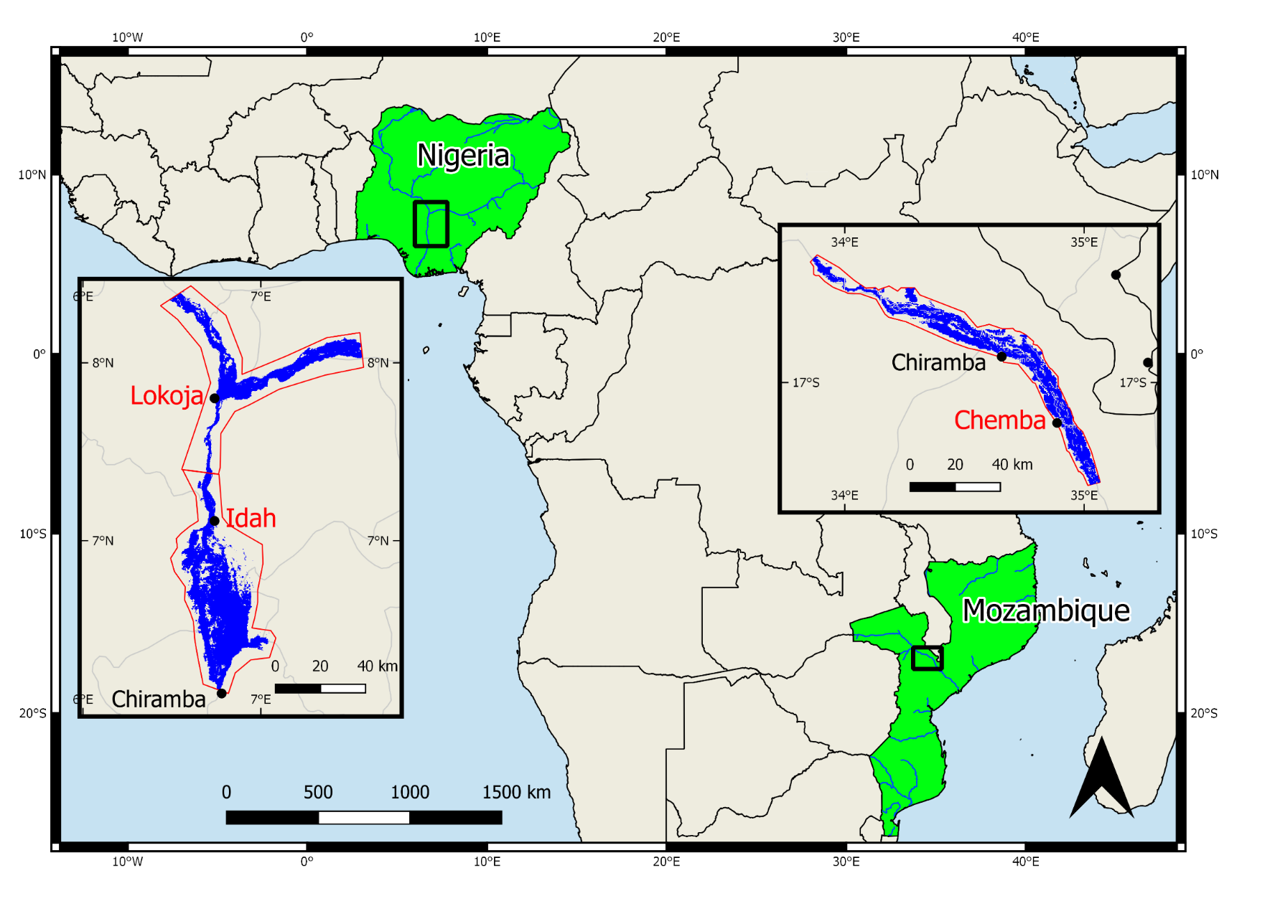
Study Regions
3 study regions, 2 flood events
2012 flooding in Nigeria of the Niger and Benue rivers
2007 flooding in Mozambique of the Zambezi river
Both events had roughly estimated return periods of 50 years
Slide 3/11

Slide 5



Performance Metrics
Critical Success Index (CSI) – proportion correct [1 best, 0 worst]
Hit Rate (HR) – proportion of observed captured by model [1 all, 0 none]
Bias – measures bias towards under (-ve) or over prediction (+ve)
Observed
(F_{o})
Agreement
(F_{o} ∩ F_{m})
Modelled
(F_{m})
$$CSI= \frac{F_{m}∩F_{o}}{F_{m}∪F_{o}}$$
$$HR= \frac{F_{m}∩F_{o}}{F_{o}}$$
$$Bias= \frac{\left(F_{m}∩F_{o}\right)+F_{m}}{\left(F_{m}∩F_{o}\right)+F_{o}}−1$$
Slide 4/11

Slide 6
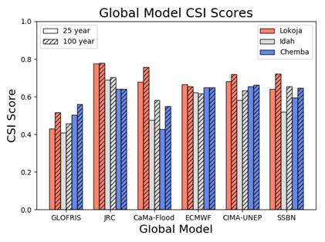
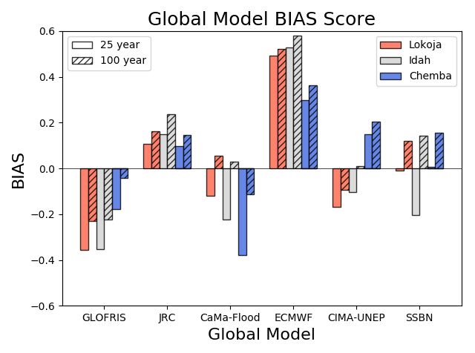
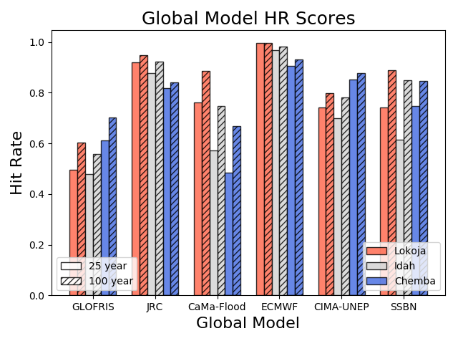
Individual Models
Models from left to right are ordered in descending order of resolution (approx. 1km, 1km, 500m, 500m, 90m, 90m)
Slide 5/11

Slide 7
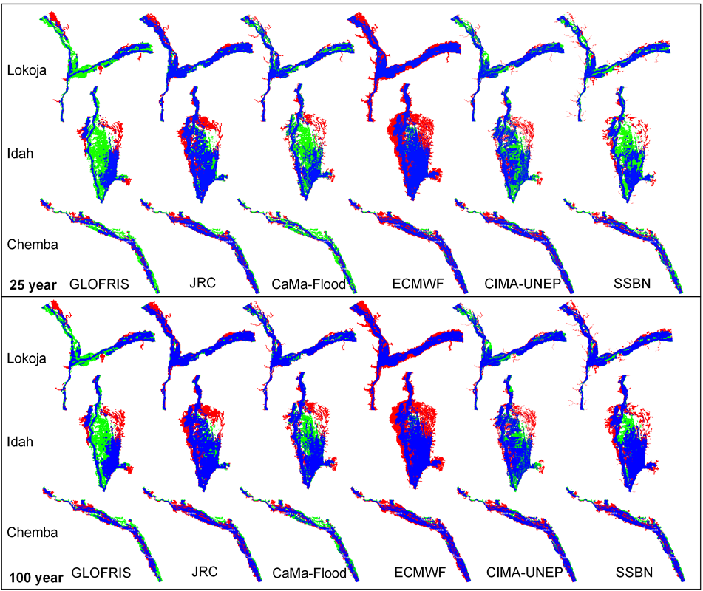
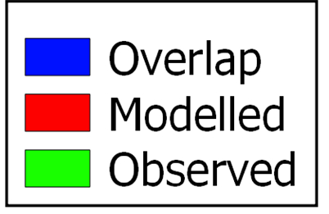
Slide 6/11

Slide 8
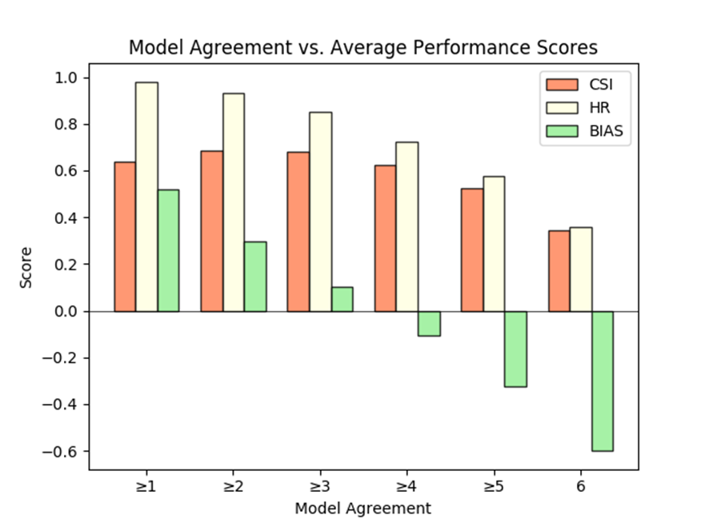
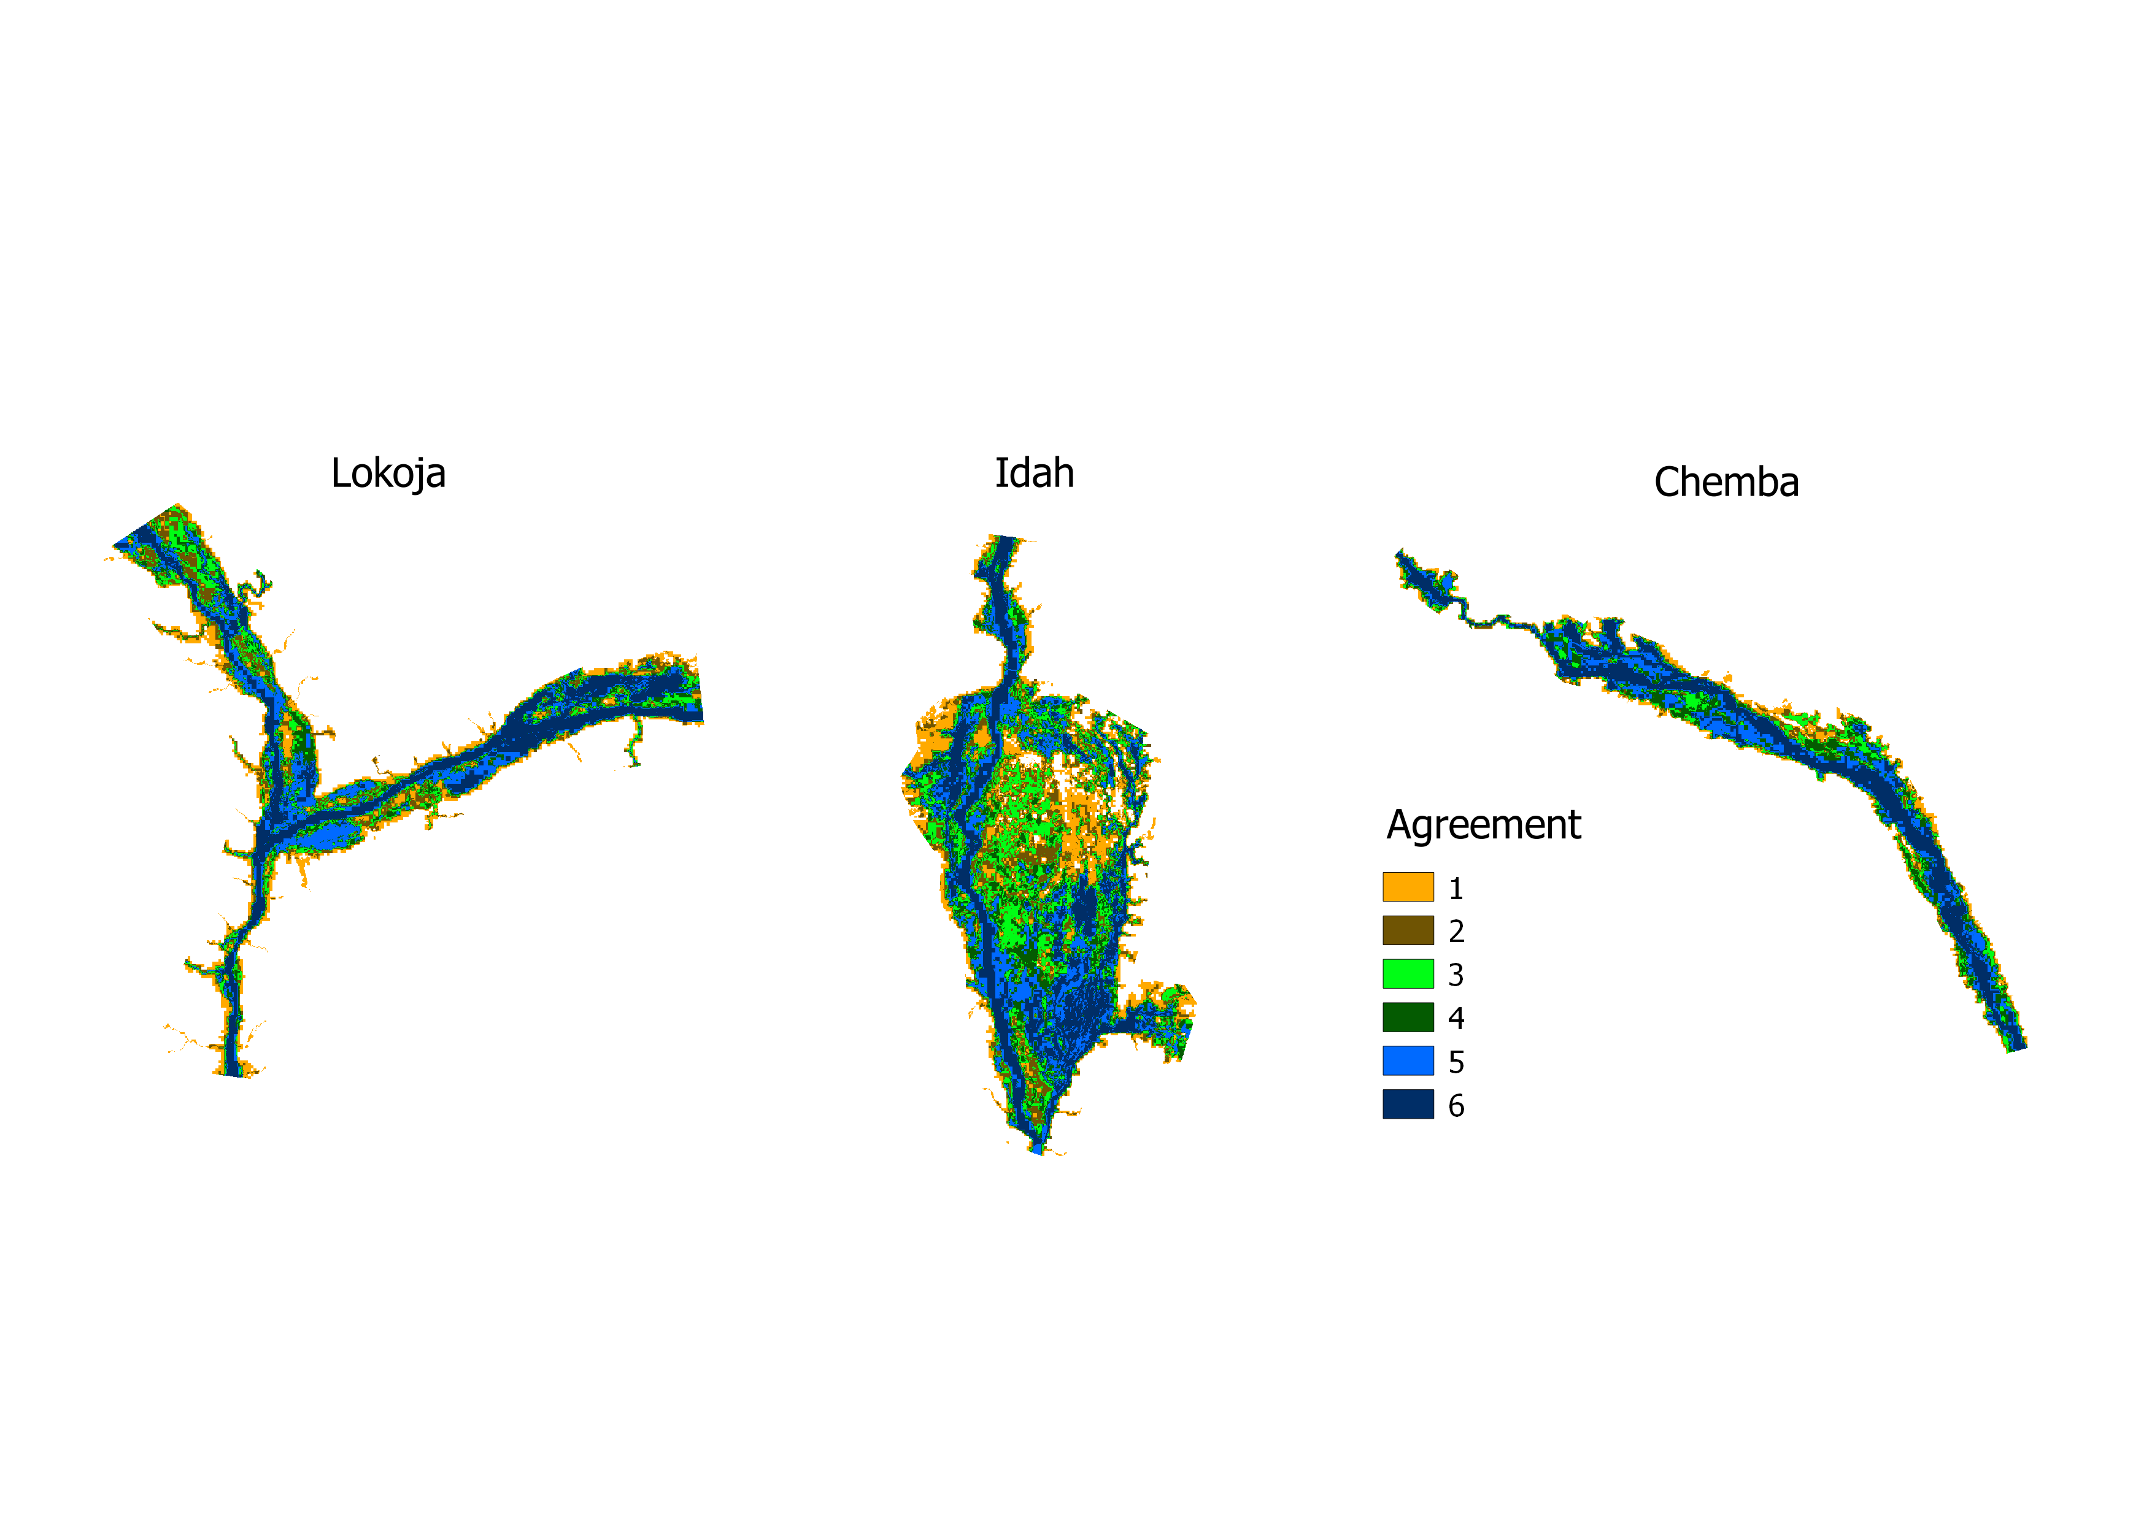
Aggregated Models
25 year return period
Mean of all three sites
All flood areas from all models
Only flood area where all models agree
Slide 7/11

Slide 9
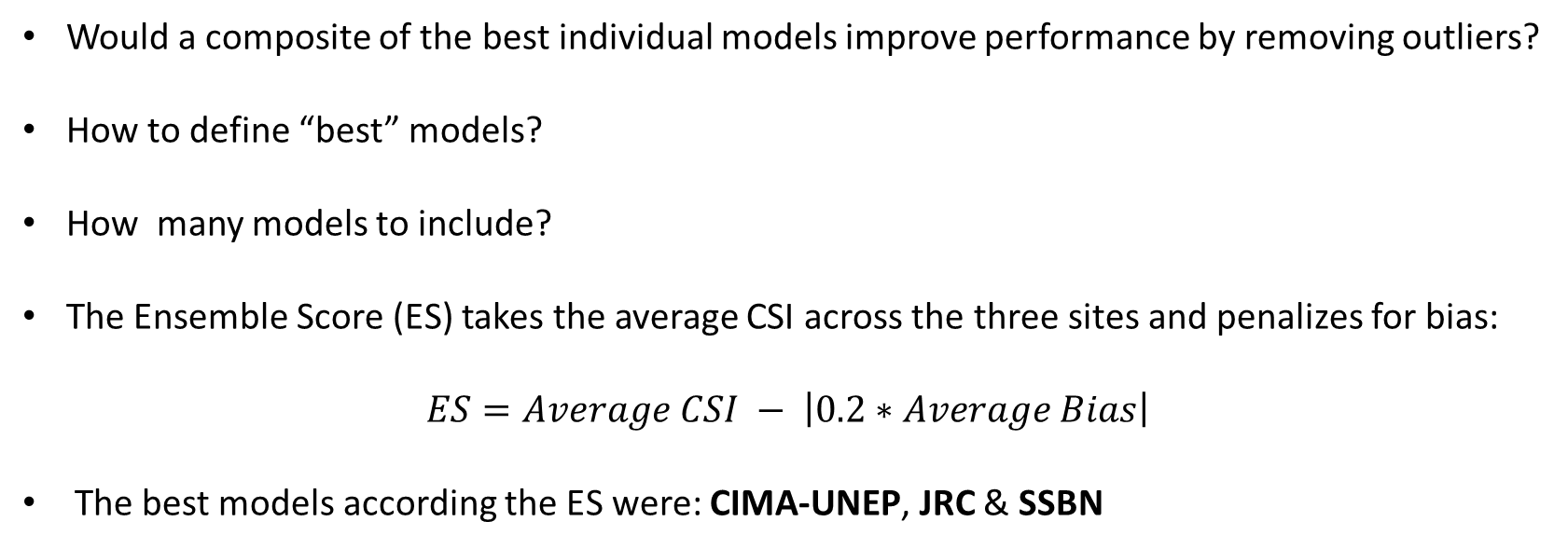
Model Combination
Would a composite of the best individual models improve performance by removing outliers?
How to define “best” models?
How many models to include?
The Ensemble Score (ES) takes the average CSI across the three sites and penalizes for bias:
$$ES=Average CSI − \left|0.2∗Average Bias\right|$$
The best models according the ES were: CIMA-UNEP, JRC & SSBN
Slide 8/11

Slide 10
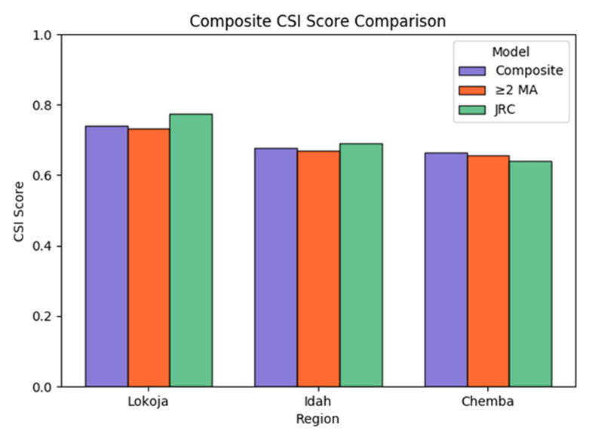
Composite Model Performance
Slide 9/11

Slide 11
Conclusions
Performance between models shows wide range of under to over prediction – hence poor agreement in original intercomparison.
Return period (input flow) has a significant effect on model performance.
Hydraulic characteristics of the region play a role in model performance.
Aggregate and composite models do not perform better than best individual model. But may be useful in regions where validation is not possible?
No apparent link between model resolution and performance.
Limitations
Some models may have been updated since this study.
Observational data assumed to be correct. May not always be the case.
Slide 10/11

Slide 12
Outlook
This study has highlighted the usefulness of a common validation procedure, going forward:
Validation should include cases to cover a wide range of locations, conditions and scales.
Expand the validation to included not only flood footprint overlap but also a comparison of modelled vs. measured flow and modelled vs. measured inundated depth.
Validation data to be shared between groups.
Slide 11/11

Slide 13
Thanks for listening
Any questions?

